Slide 1
FINAL PROJECT Introduction to Data Science
GROUP 3:
Vrushali Ravi Lad​
Shilpa Vijay Mohan Pillai​
Rijul Narendra Ugawekar​
Abhijeet Anil Baviskar​
Inavilli Meghana Shivani

Slide 2

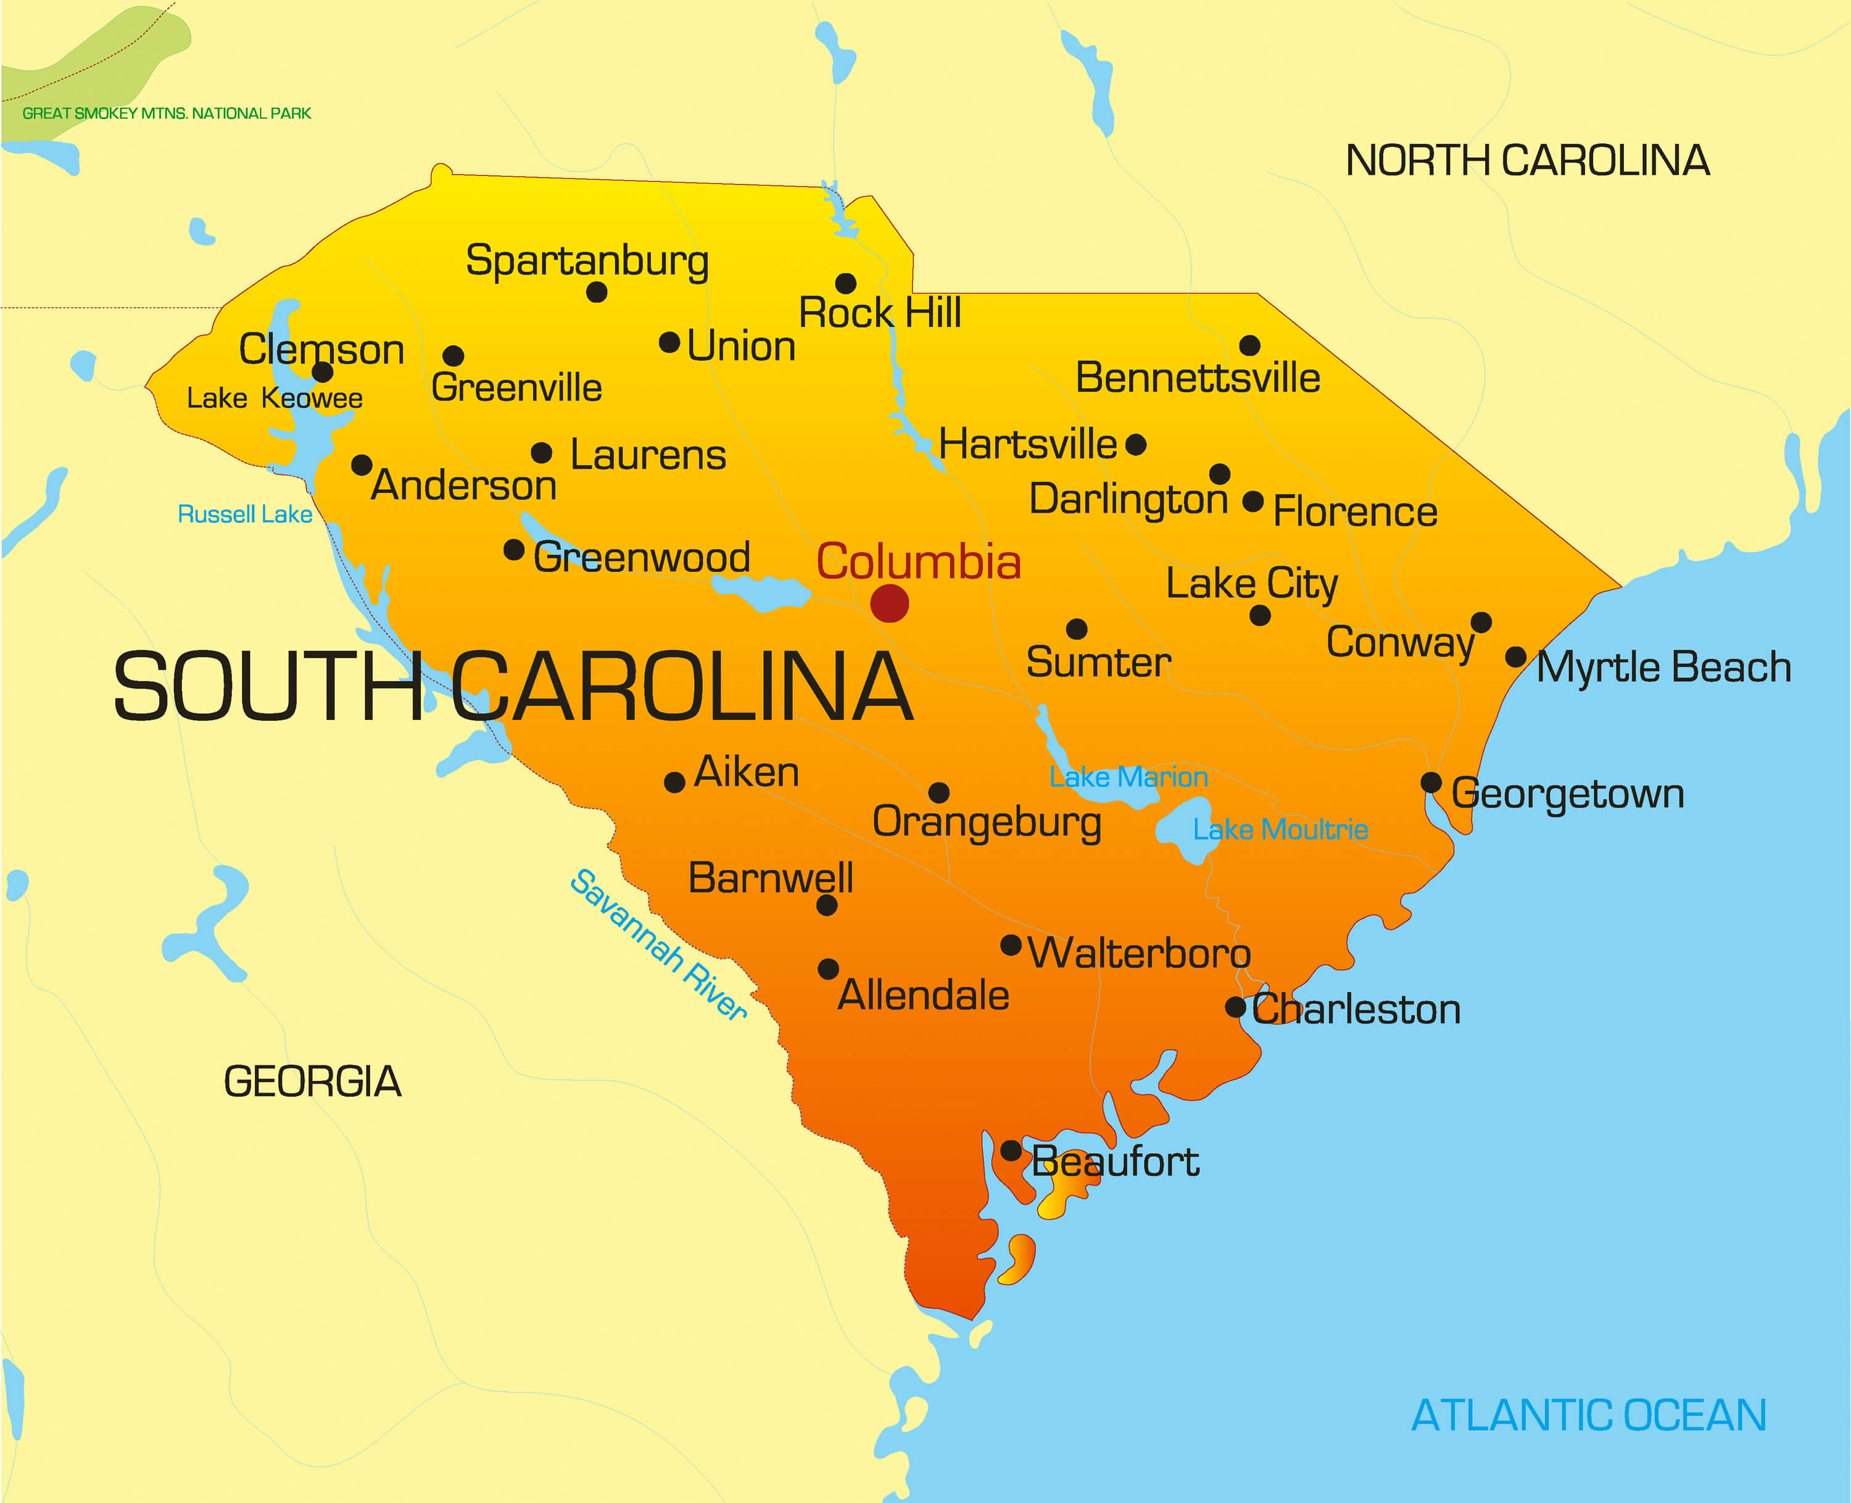
PROJECT GOAL:
Analyze energy use factors on peak July days in South Carolina households, devising strategies to promote energy-saving behaviors in hot months and prevent system strain.

Slide 3

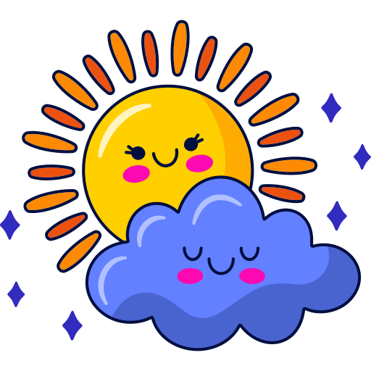

DATA
3 CSV FILES
ENERGY USAGE DATA
WEATHER DATA
STATIC HOUSE DATA
Specific location-related weather details
Energy consumption metrics with environmental and residential property characteristics.
Residential energy usage data with house attributes and environmental factors.

Slide 4
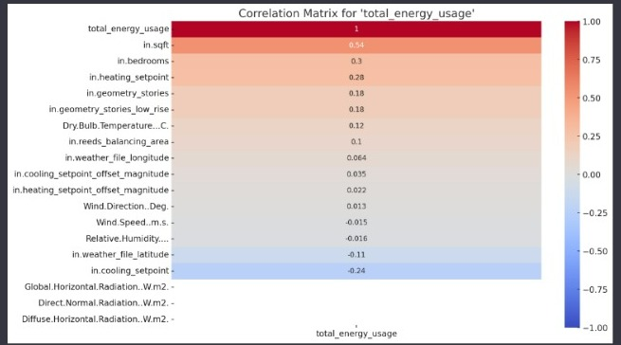
FEATURE ENGINEERING

Slide 5
RECOMMENDATIONS FOR ENERGY SAVING

Slide 6
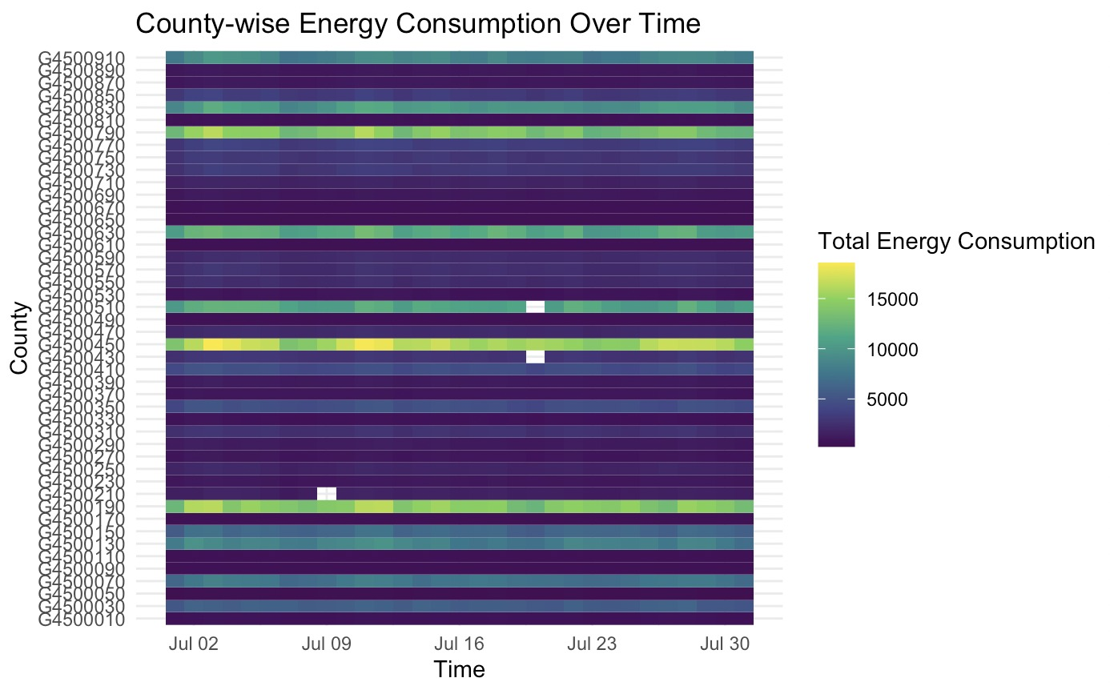
DAILY TOTAL ENERGY CONSUMPTION BY COUNTY

Slide 7
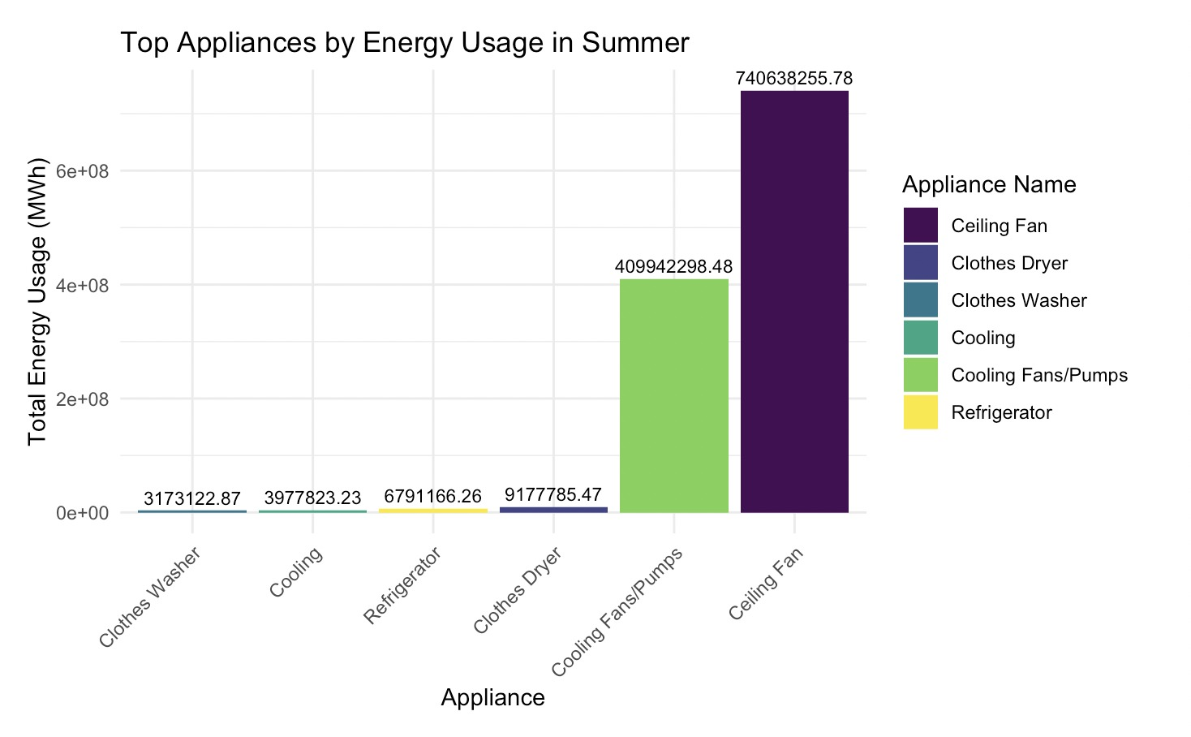
CEILING FAN
Recommendation 1:
Switch to Energy-Star fans for substantial energy savings without compromising comfort.
Educate occupants to optimize fan use by turning them off when not needed, reducing unnecessary energy consumption.

Slide 8
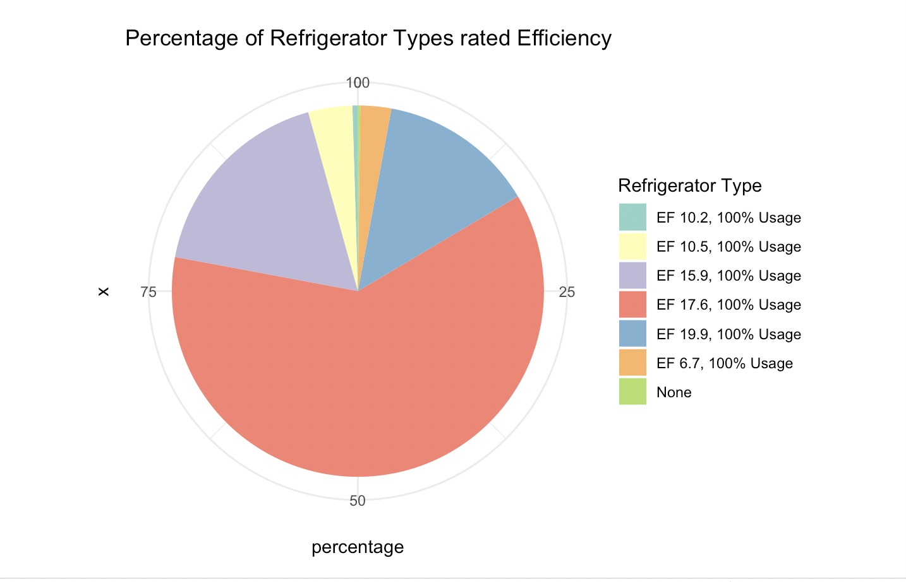
REFRIGERATOR
Recommendation 2:
Upgrade Refrigerator to EF 19.9+ models :
EF – Energy Factor(Measure of how efficiently an appliance uses energy to perform its intended function)
Swapping over 50% of EF 17.6 models with newer, more efficient options promises both energy savings and cost advantages.

Slide 9
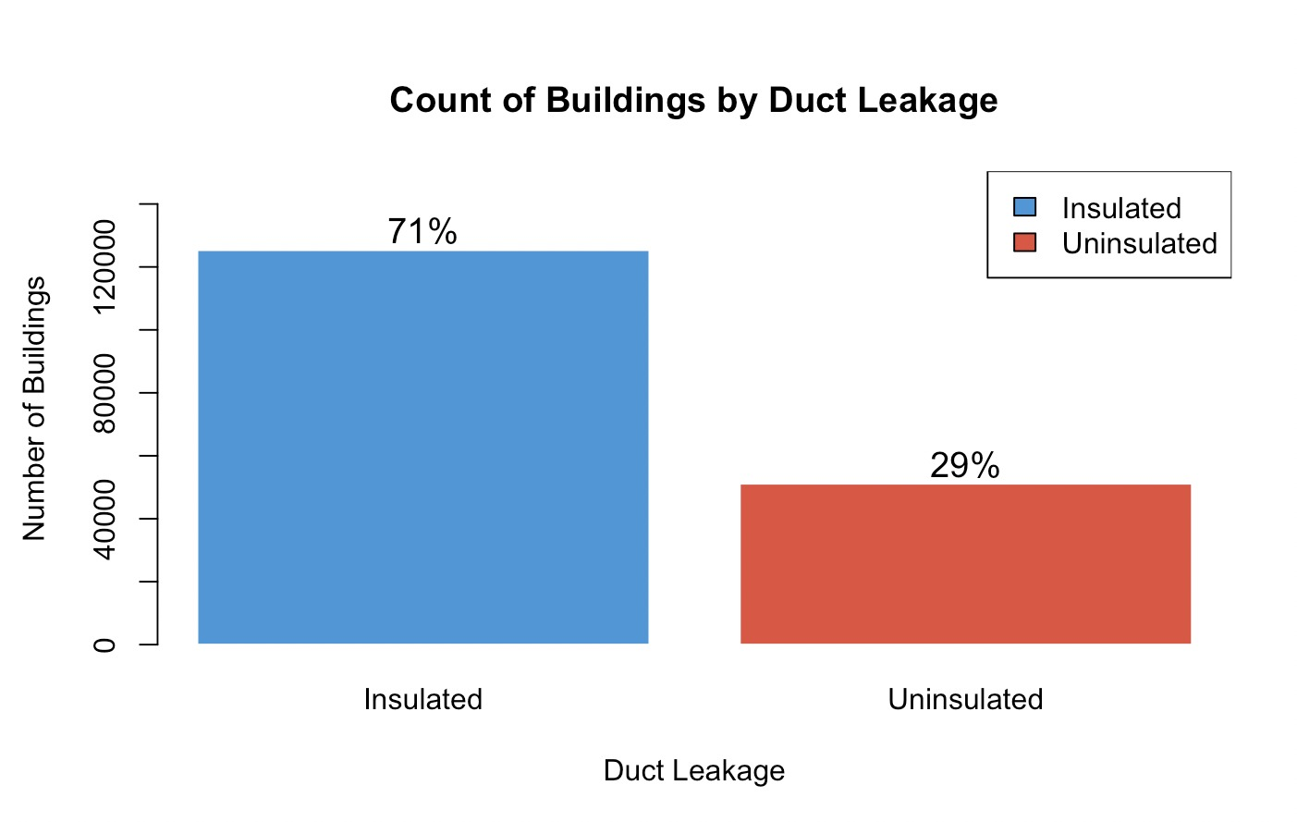
DUCTS
Recommendation 3:
Seal air leaks and insulate:
These actions can save up to 30% on heating and cooling costs, contributing significantly to overall energy savings.

Slide 10
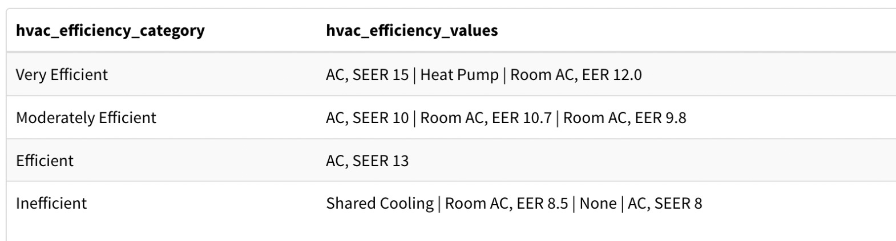
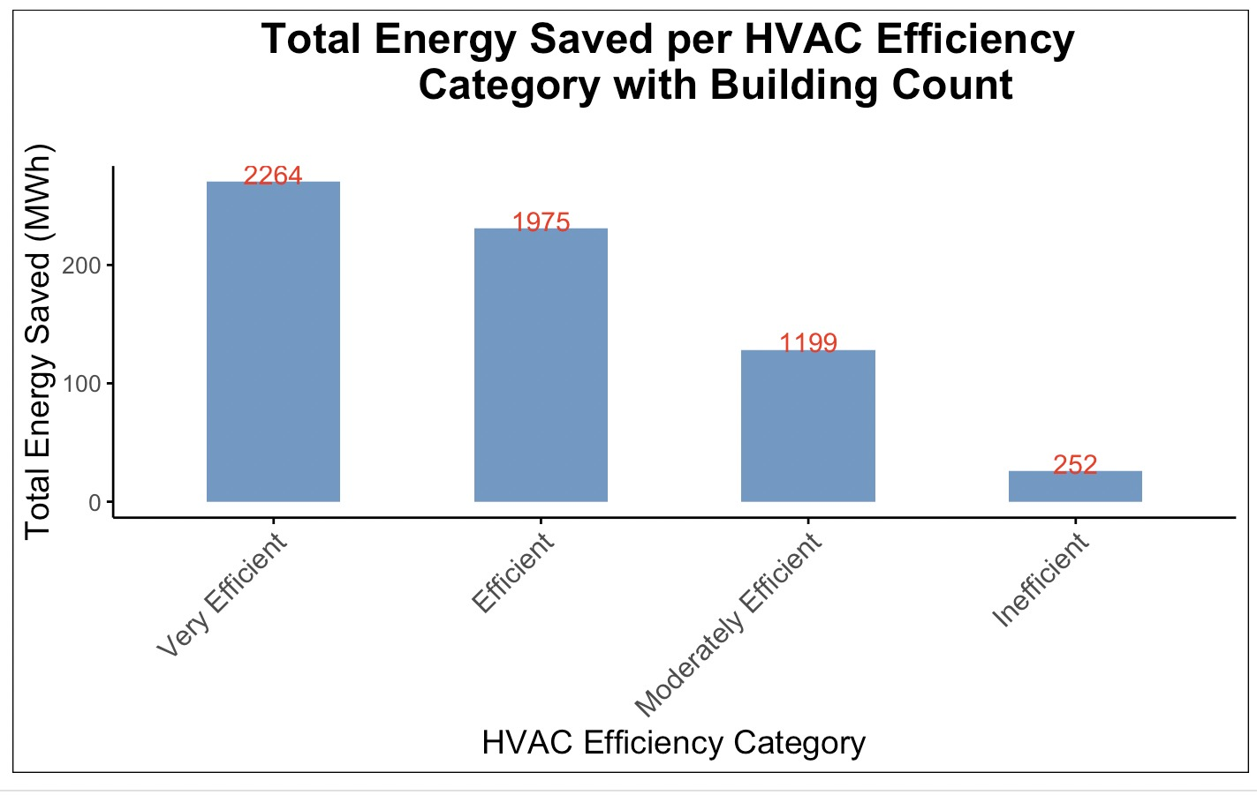
AC
Recommendation 4:
Upgrade AC:
3,426 of 5,000 buildings (68.52%) rely on inefficient AC systems, suggesting upgrades to new, energy-efficient models for significant savings and improved comfort.

Slide 11
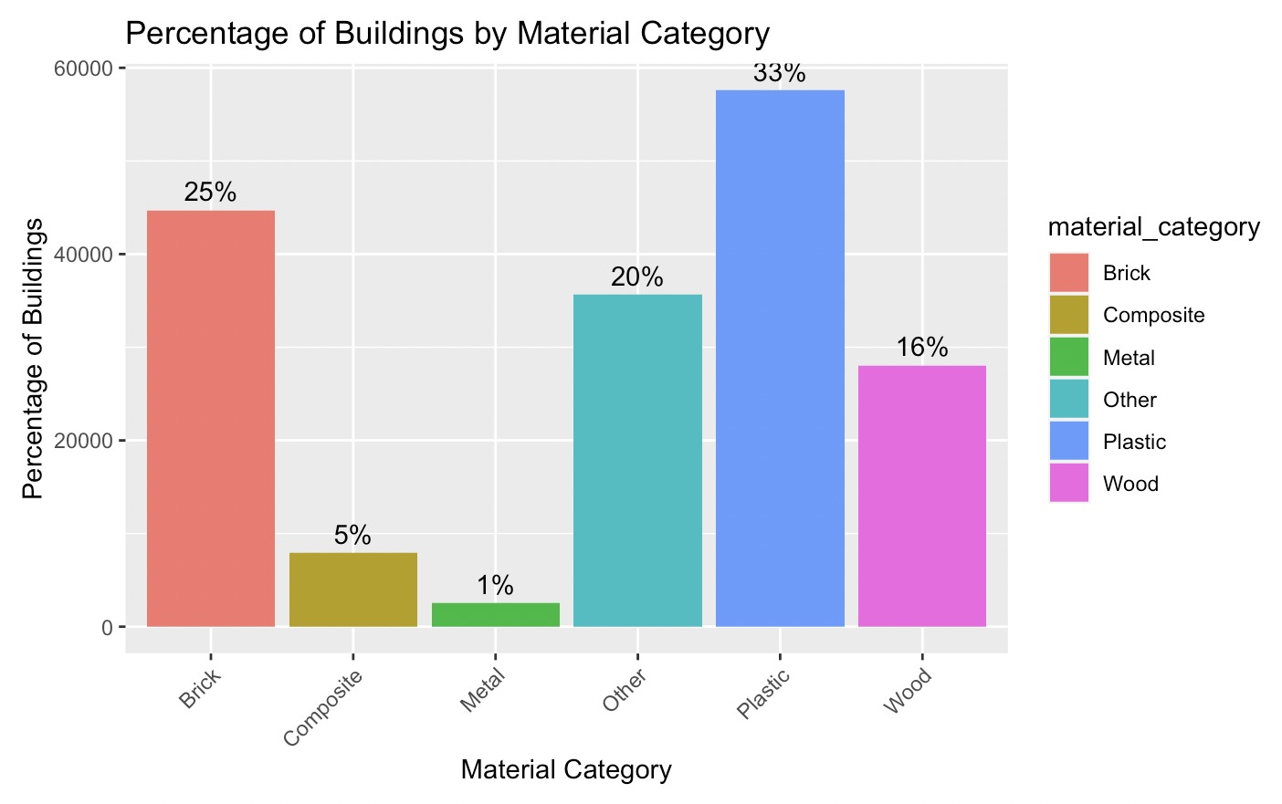
MATERIAL
Recommendation 5:
Conduct regular energy audits to identify and implement targeted improvements for the highest energy-using materials, like plastic and "other" categories.

Slide 12
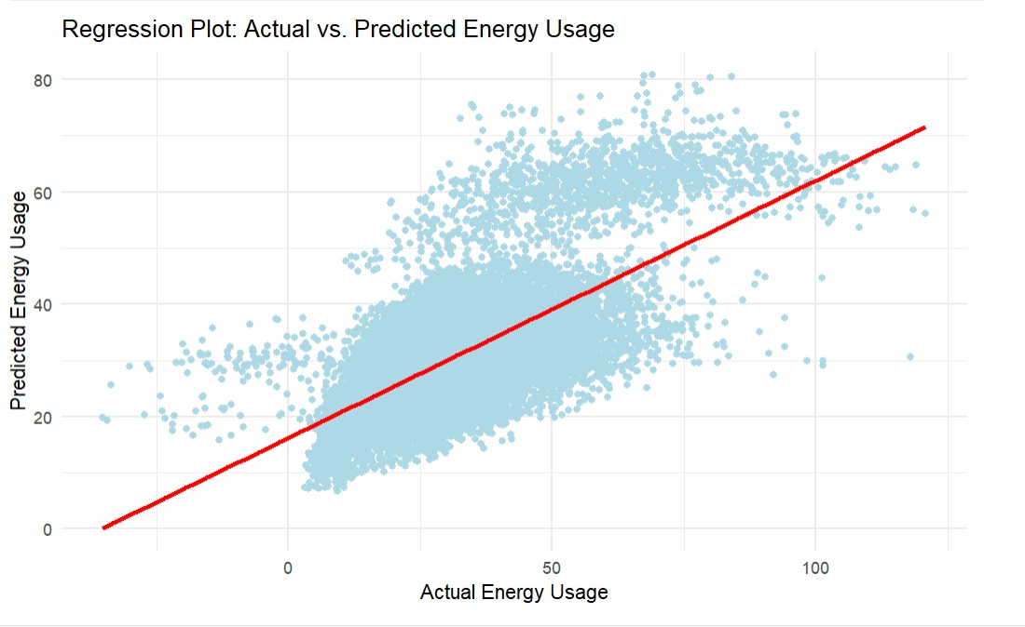
ACTUAL VS PREDICTED ENERGY USAGE

Slide 13
SHINY APP
https://rijulugawekar17.shinyapps.io/IDSFINAL/
Analyzing energy consumption patterns.
Identifying the main drivers of high energy usage.
Simulating future demand under 'extra hot' summer conditions.
Informing targeted energy-saving strategies and customer education programs.
Preventing blackouts by managing peak load demands more effectively.
By understanding these factors, eSC can devise interventions to encourage energy conservation, especially during high-demand periods, without needing to expand their infrastructure.

Slide 14
THANK YOU

